Slide 1
SAP Cloud Platform Integration Overview
Bangalore, Rajkumar

Slide 2
Table of Contents
SAP Cloud Platform
1
SAP Cloud Platform Integration – Overview
2
SAP CPI vs SAP PI/PO– When to use what?
3
SAP CPI to On-premise connectivity
4
Integration Solution Cloud vs. On-Premise
5
Different commercial models and which one is right for your client ?
6
7
SAP Cloud Platform Integration Service
8
SAP Cloud Platform Integration Naming Convention

Slide 3
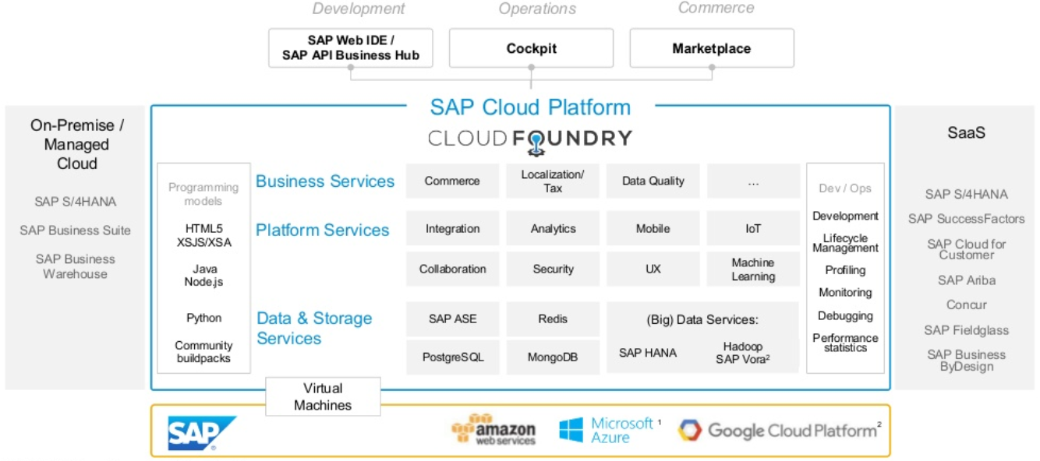
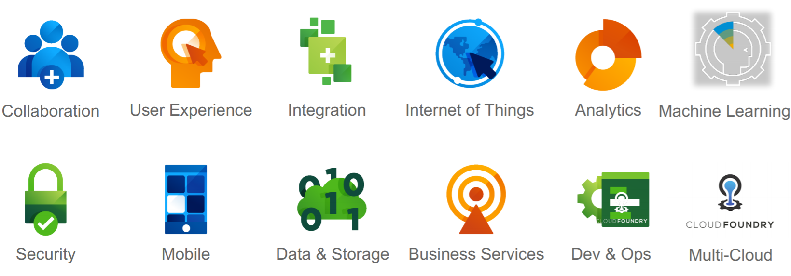
1. SAP Cloud Platform
What is SAP Cloud Platform?
SAP Cloud Platform is an open platform-as-a-service (PaaS) that delivers in-memory capabilities, core platform services, and unique microservices for building and extending intelligent, mobile-enabled cloud applications.
SAP Cloud Platform Capabilities
https://cloudplatform.sap.com/index.html

Slide 4
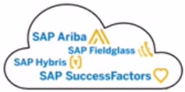
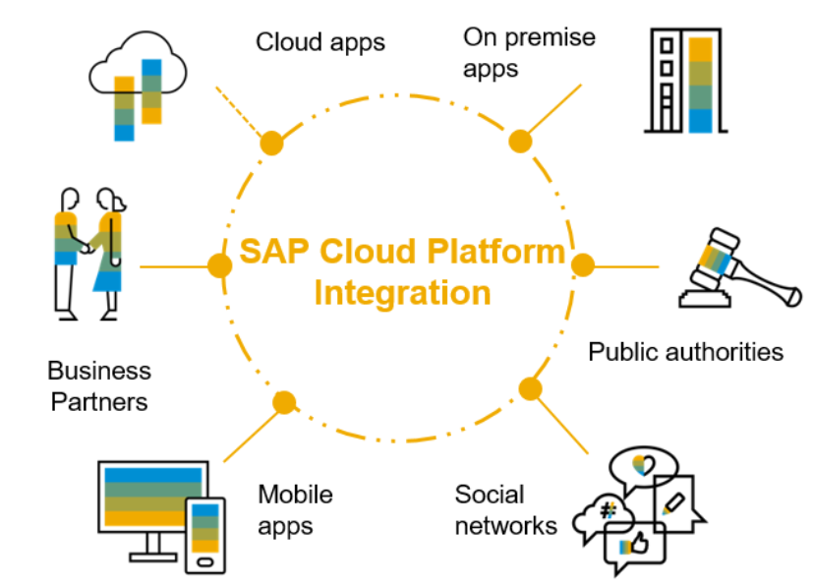
2. SAP Cloud Platform Integration – Overview
Faster innovation, thanks to shorter project and upgrade cycles
Scalable Cloud Integration Platform as the gateway to cloud first strategy
Minimal Upfront Investment
Lower total cost of ownership
SAP Cloud Integration offers many capabilities, including:
Connect any applications:
  SAP and non-SAP, Java and ABAP systems
  On-premises and in the cloud
  Communicate reliably at large scale with enterprise messaging service
  Send and receive high number of messages in real-time
Integrate processes and data:
  Intra-and inter-company processes with SAP Cloud Platform Integration
  ETL between on-premises and cloud repositories
Centralized monitoring and management of integrations.

Slide 5
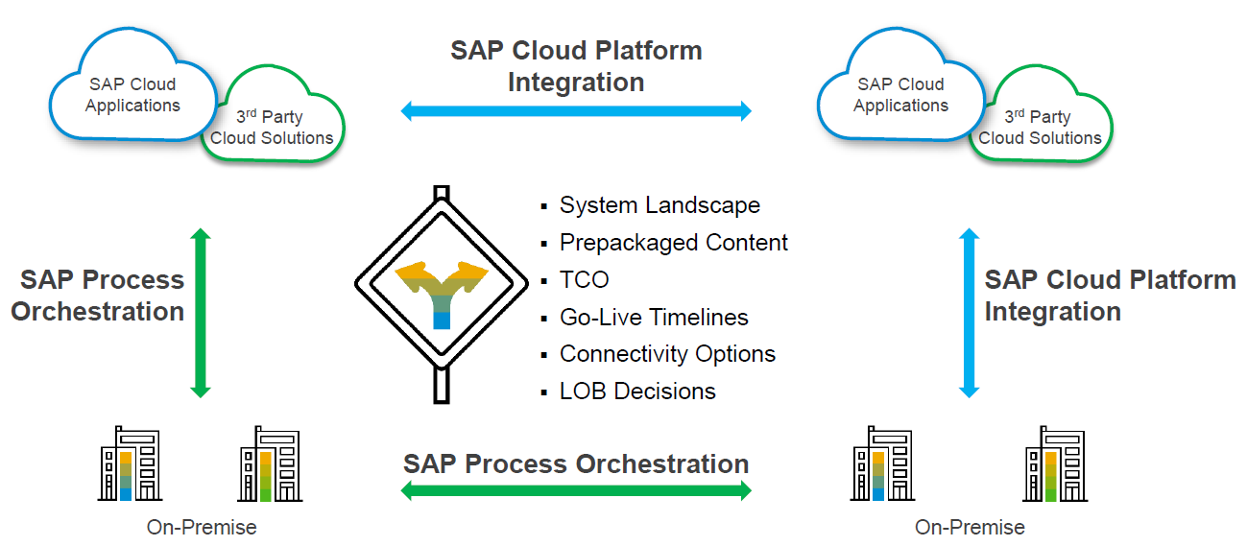
3. SAP CPI vs SAP PI/PO – When to use what?
A complementary offering to SAP Process Orchestration

Slide 6
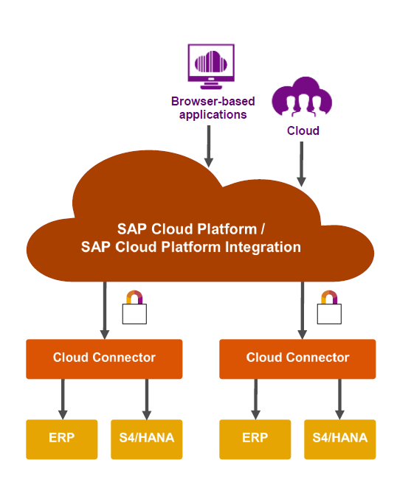

4. SAP CPI to On-premise connectivity
The Cloud Connector allows you to securely connect your on-premise backend systems to the SAP Cloud Platform
Establishes secure SSL tunnel between SAP Cloud Platform and the customer’s on-premise network runs as an on-premise agent and acts as a reverse invoke proxy
DMZ
On-Premise(behind DMZ/Firewall)

Slide 7
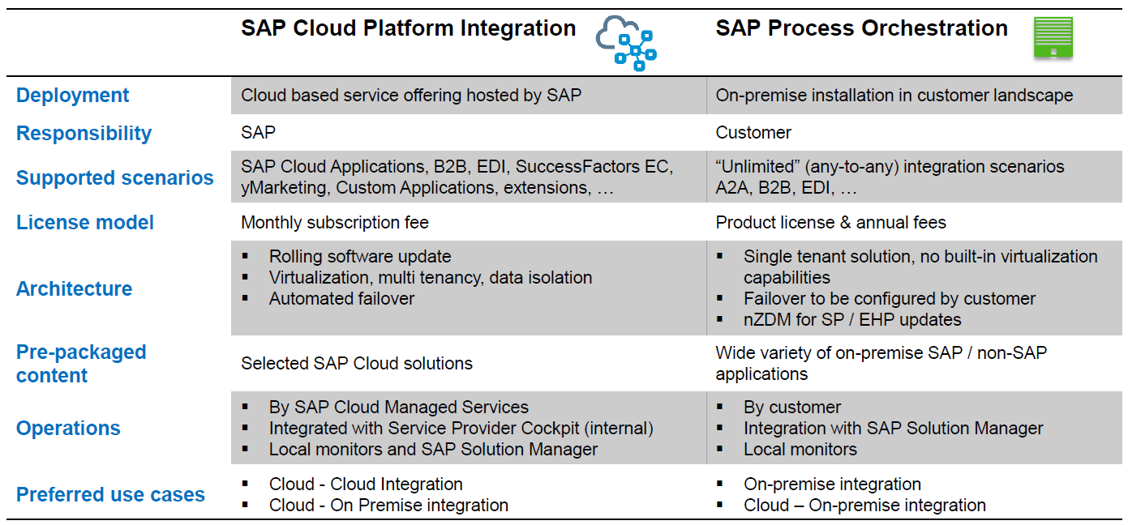
5. Integration Solution Cloud vs. On-Premise

Slide 8
6. Different licencing models and which one is right for your client ?
 | Subscription-based | Consumption-based
Usage | You know the exact services and their usage for your business/projects. | You need the agility to use and consume all the services required for new business initiatives.
Additional Services | You do not expect to add new services during the subscription period. | You need the flexibility to add services and stop usage of other services.
Scalability | You prefer to negotiate upfront and not worry about scaling usage per service. | You want the transparency to see which services are being over and under-utilized.
Self-Service | You prefer paying for a consistent fee for all the contracted services. | You want a self-service approach to adding or stopping services.

Slide 9
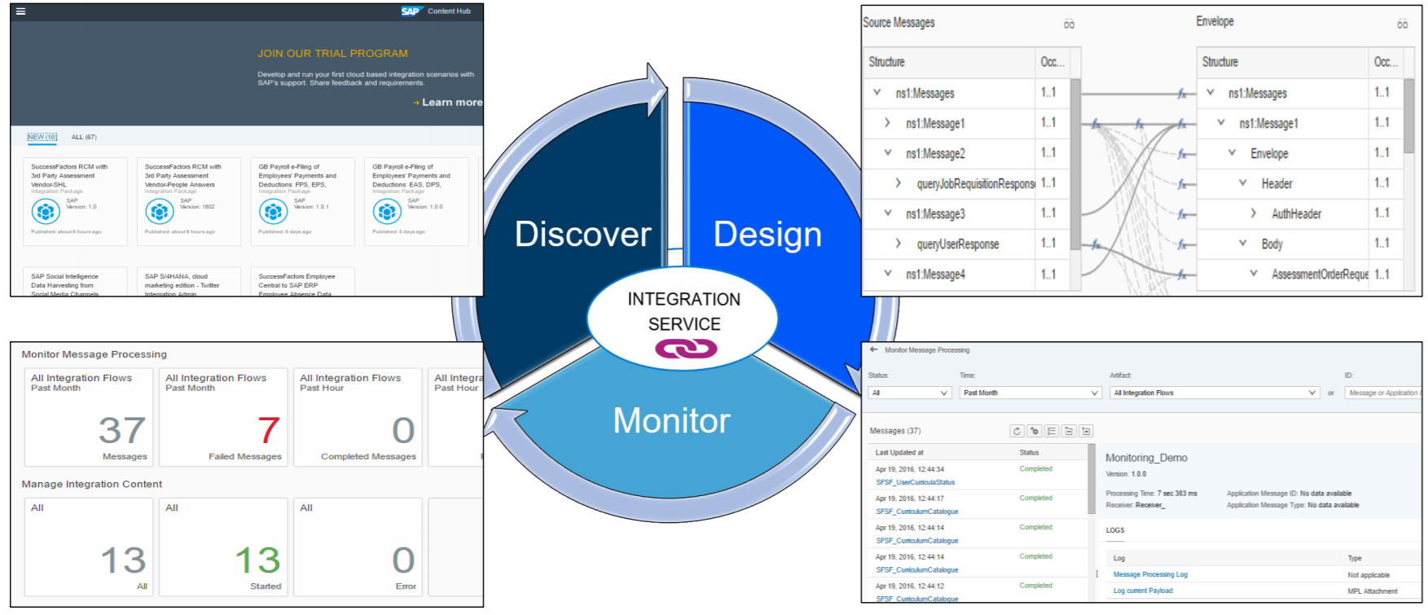
7. SAP Cloud Platform Integration Service

Slide 10
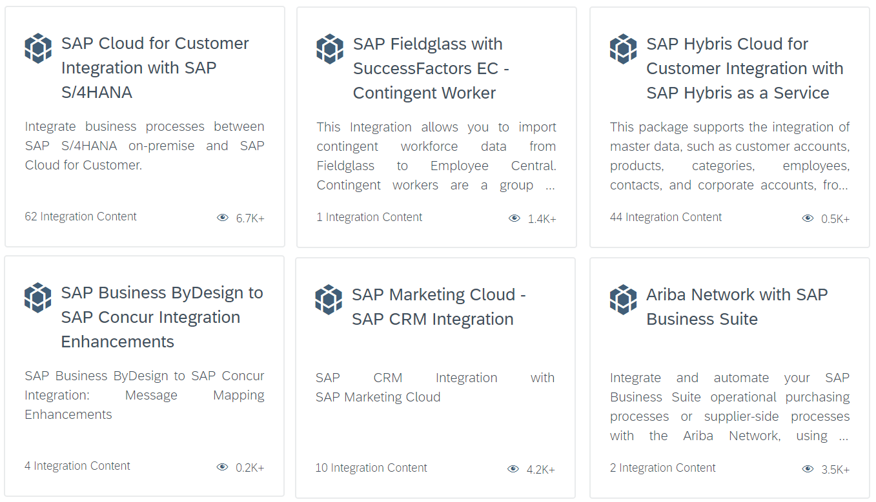
7.1 Discover - Prepackaged CPI contents
SAP provided many pre-packaged APIs and Integration flows for many well know integrations need.
  It helps client to jump-start integration projects and quickly complete productive scenarios.
  It is more reliable since SAP understands its products and integration need.
  Most of the times it is like plug and play for the client with minimal build and testing.
https://api.sap.com/
https://api.sap.com/shell/integration

Slide 11
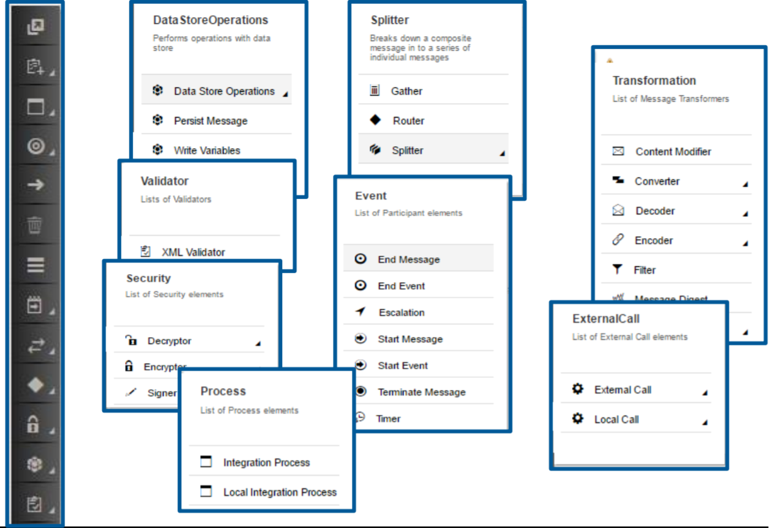
7.2 Design – Integration Content
Flexible design pipeline
Independent and reusable process steps
40+ different steps available
  Message Transformation
  Message Mapping
  Message Routing
  Security Elements
  Scripting
  Tasks
  Data Store Operations
  Events
  Many more…

Slide 12
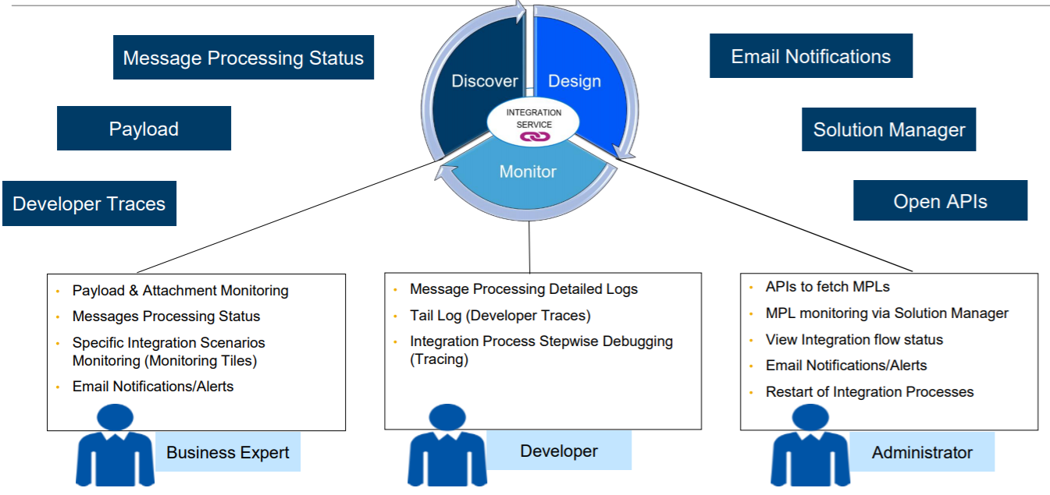
7.3. Monitor – Integration Content

Slide 13
8.SAP Cloud Platform Integration Naming Convention

Slide 14


